Slide 1
Twitter Sentiment Analysis
(R shiny)
Gautam Gowrishankar

Slide 2
What is it about
Objective
Context
Dataset
With the help of Shiny framework, created an interface that allows the user to give the number of tweets that they would like to analyze along with the radius of the area in the United States that they would like to cover.
Input is in the form of extracted data from Twitter, performing text mining to build word clouds for positive and negative sentiments and understand the overall sentiments for the given search criteria.
The objective of this project is to create a user interface using Shiny to enable users to evaluate the sentiments of the tweets based on either a given twitter username or a trending Twitter hashtag

Slide 3
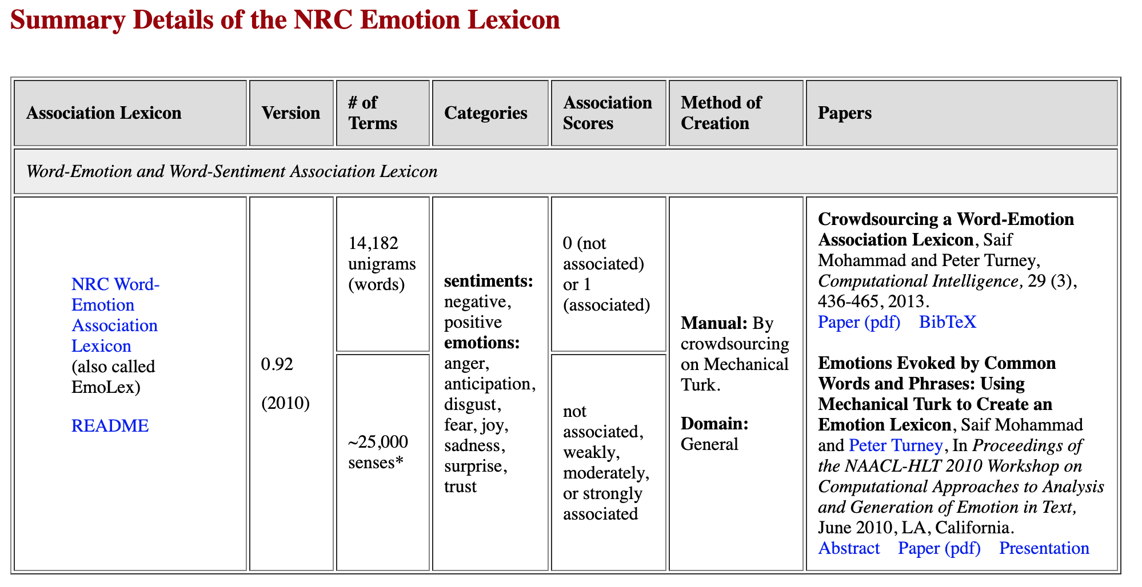
Approach deep-dive
Stage 1
Stage 2

Slide 4
One of the experimentation was in relation to the effectiveness of ‘stopwords’. Investigating whether removing ‘stopwords’ helps or hampers the effectiveness of twitter sentiment classification methods.
Are dynamic stopword list any different. Ended up pitting dynamic stopword lists against traditional lists.
In order to create dynamic stoplists, we used Zipf’s Law using Inverse Document Frequency to eliminate High Frequency terms and then compared the results obtained by traditional stoplists.
Created positive and negative Wordclouds based on the aforementioned approach and also to illustrate more clearly the differences.
NUTS & BOLTS

Slide 5
Implementation

Slide 6
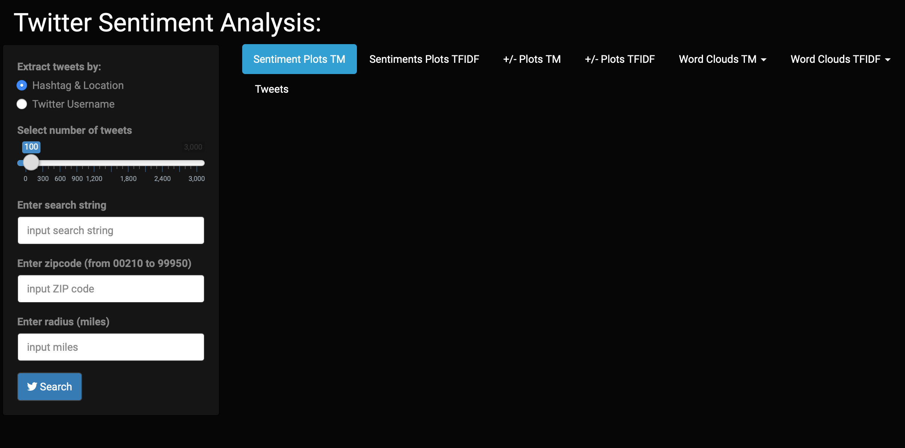
User can either search by a particular text phrase or by a specific valid username.
ZIP code and radius are the other params.
Clicking on search will reveal the plots
Interface

Slide 7
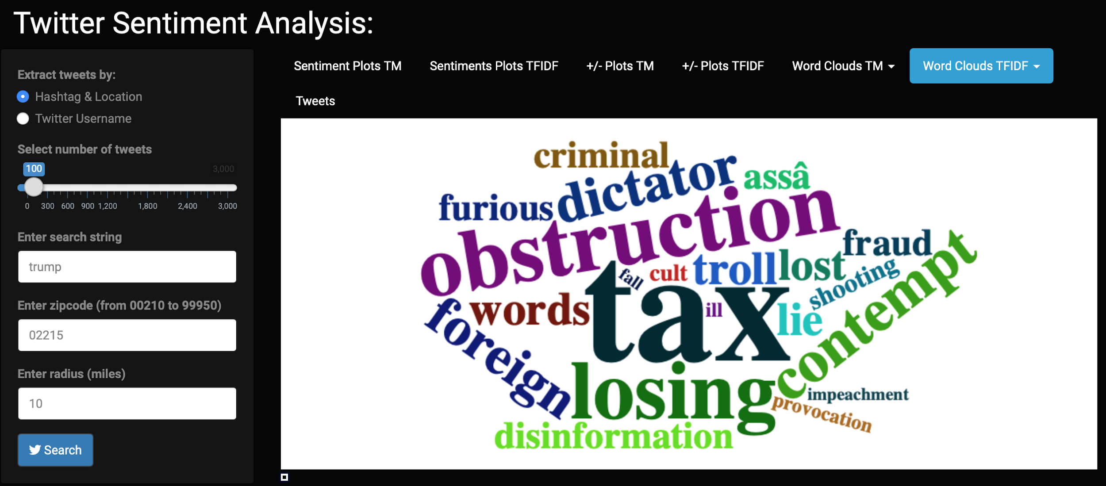
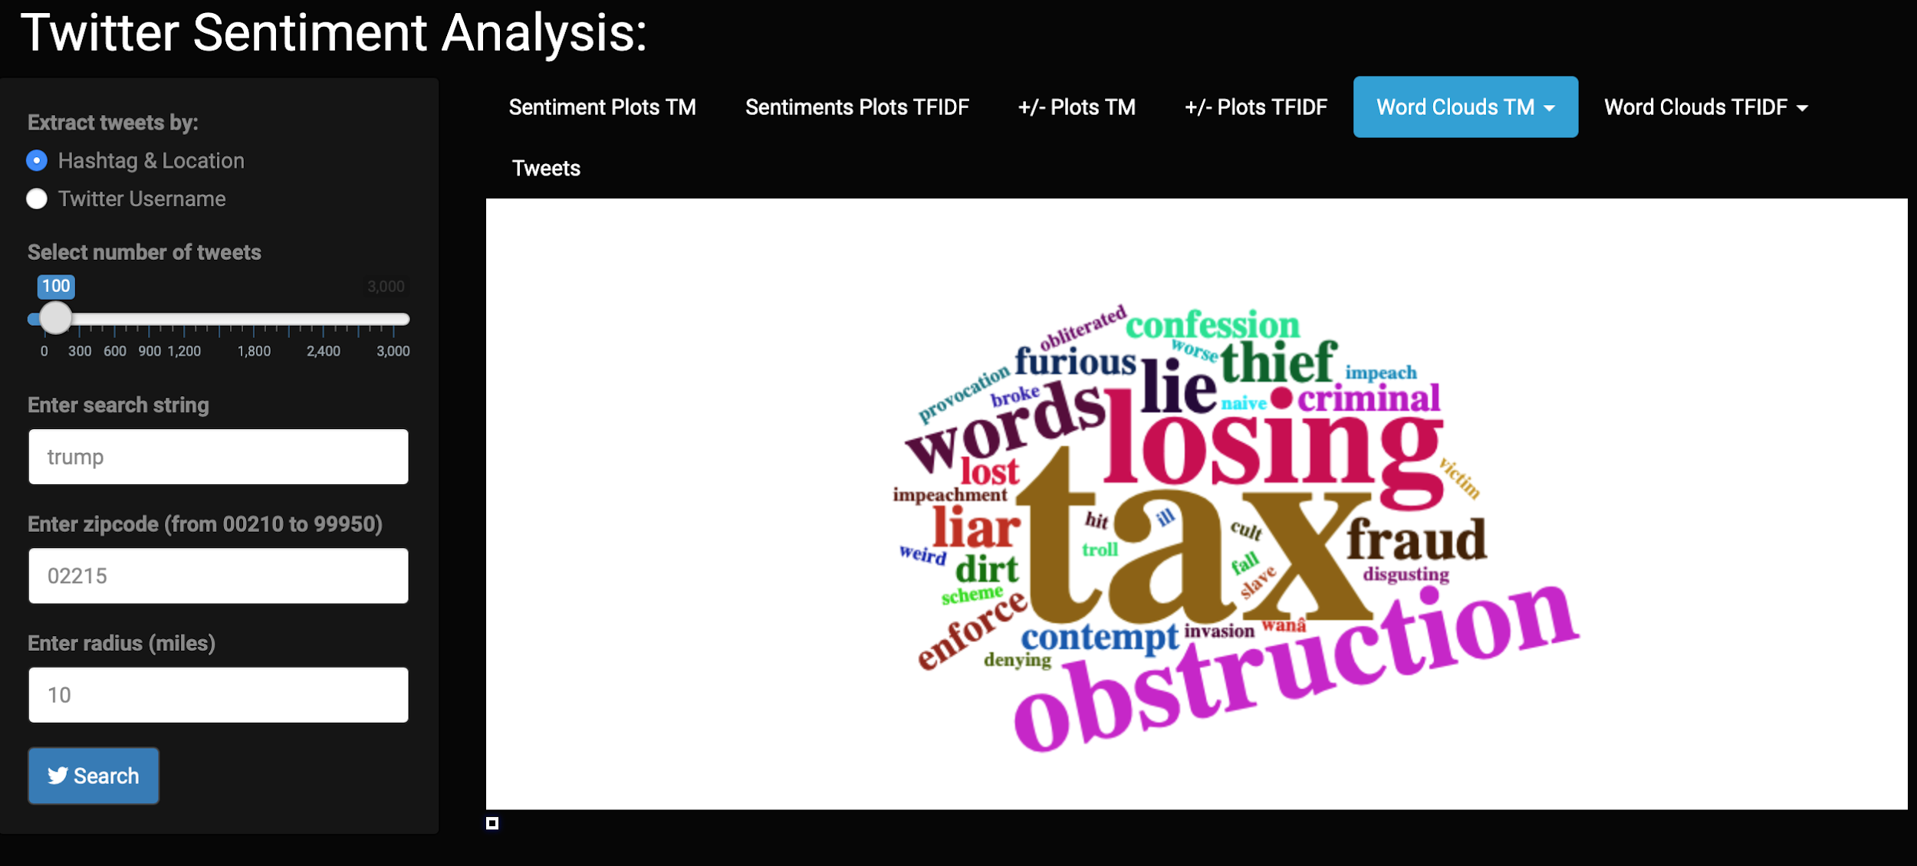
WordCloud using TFIDF
WordCloud without TFIDF

Slide 8
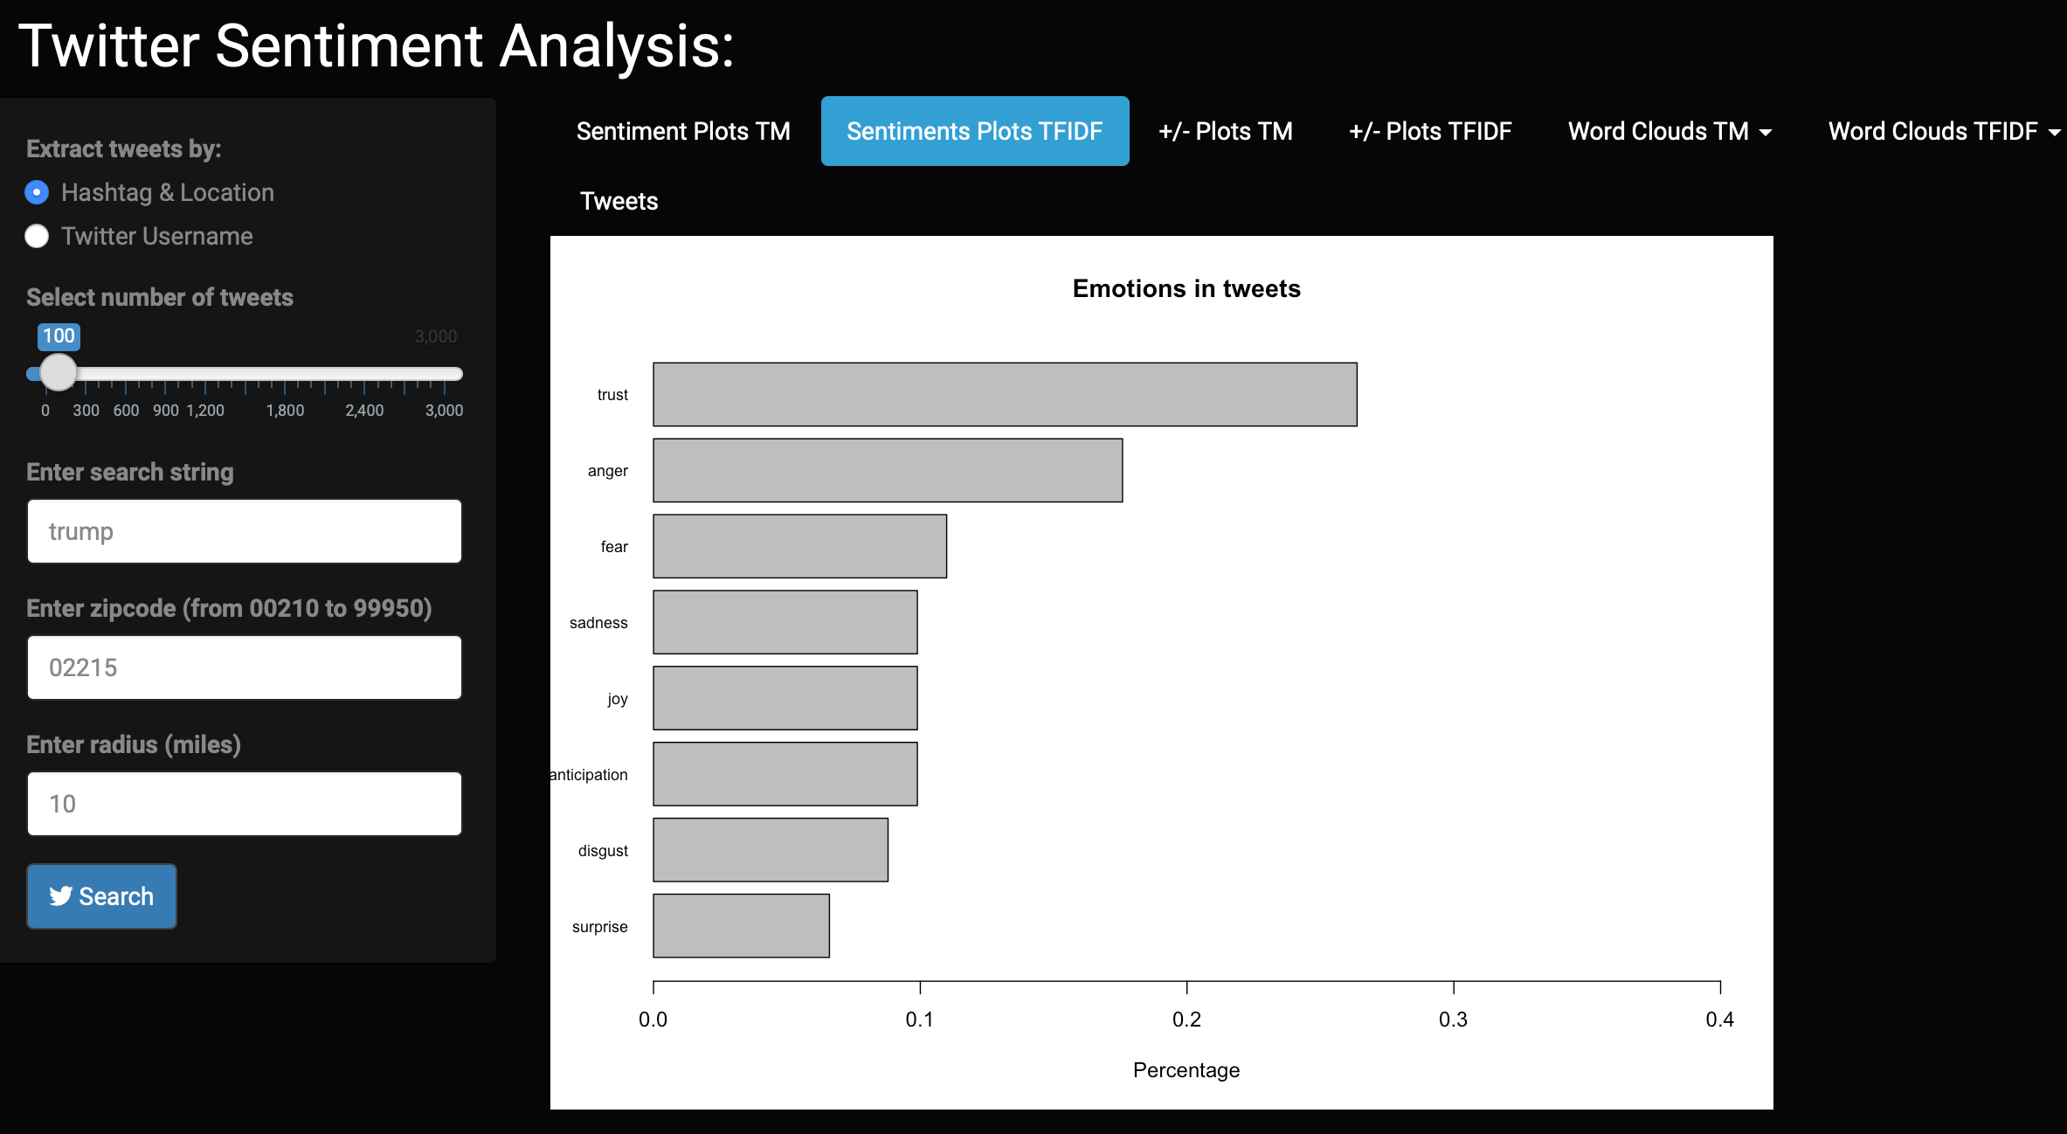
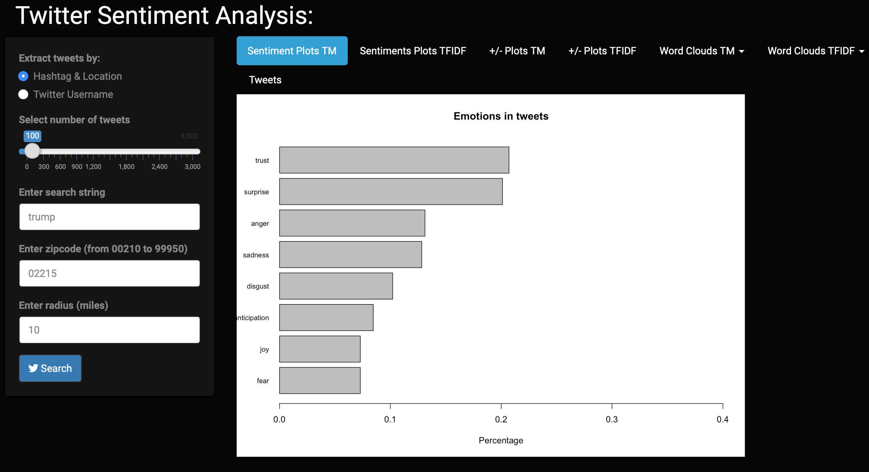
Sentiment plot using TFIDF
Sentiment plot without TFIDF

Slide 9
fin -

